Slide 1
CS 290 – Web Development.

Slide 2
Agenda
More Javascript
Some background
Understanding syntax
Scope
Objects
Closure
Function Overloading
“Java is to JavaScript what Car is to Carpet.” ― Chris Heilmann

Slide 3
ECMA
European Computer Manufacturer's Association
ECMA oversees ECMAScript which JavaScript adheres too
2011 released version 5.1 of ECMAScript specification. Further versions are in progress.
Firefox and Chrome started adhering to the standards, IE followed.
Chrome’s v8 engine was the fastest JS engine
“Fortunately, JavaScript has some extraordinarily good parts. In JavaScript, there is a beautiful, elegant, highly expressive language that is buried under a steaming pile of good intentions and blunders.” ― Douglas Crockford, JavaScript: The Good Parts

Slide 4
Setting a definition for compatibility
How do you determine the oldest browser that your site should work on?
Follow the market
Identify and analyse your current web traffic
Set your own standards?
For example, identify the most critical feature of your implementation and let that guide support.
IE 10 is often sited as the current floor

Slide 5
Variables
JS stores data in one of two ways
By copy
By reference

Slide 6
By Copy
A variable holding a “primitive” data type holds its value by copy
Numbers
Strings
Booleans
null
undefined
Remember: JS is dynamically typed. Variable types do not have to be declared in advance.

Slide 7
By Reference
Any variable that does not hold a primitive type, holds value by reference
What is a reference?
Can you name a type of data typically held by reference?

Slide 8
For example
In the code below, what is the output of the two alert statements
var arr = [1,2,3,4];
var arr2 = arr;
arr2[arr2.length] = 5;
alert( arr.length + " v/s " + arr2.length); //value??
var dim = 365;
var dim2 = dim;
dim2++;
alert("dims= "+dim + "dim2=" + dim2); //value???
Notes:
Arrays are held by reference so when you copy over - its only the reference that gets copied over
but regular variable is copied by value.

Slide 9
Brief note about array
Arrays are objects.
If you simply copy an array - it just passes the reference. Like pointers in C
There are some nifty methods to use on arrays
array.length
concat, find, forEach, indexOf, join, slice, shift, unshift, pop, push, sort

Slide 10
Objects
Basically, anything that’s not the primitive datatype is treated as an object.
var obj {
prop1: 10;
};

Slide 11
For example
A reference to a reference is?
var obj = new Object(); //can also say: var obj ={};
var obj2 = obj;
var obj3 = obj;
obj.prop = 50;
obj2.prop=51;
alert( "prop= "+ obj.prop + " : " + obj2.prop ); //value???
obj3.prop2 = 101;
alert( "prop2= " + obj.prop2 + " : " + obj2.prop2 + " : " + obj3.prop2); //value???

Slide 12
Creating objects
// Creates a new Object object and stores it in 'obj'
var obj = new Object();
// Set some properties of the object to different values
obj.val = 5;
obj.click = function(){
console.log('hello');
};
// Alternatively, using key-value pairs
var obj = {
// Set the property names and values using key/value pairs
val: 5,
click: function(){
console.log('hello');
}
};
Like other OOP languages, you can control inheritance of objects. Look up object.seal and object.freeze

Slide 13
A note
Javascript is a prototypal language, not a classical language
For example, Java is a classical language, a definite structure and everything needs a class.
In Java/C++, is a class an object?
In a prototypal language, objects inherit from other objects.
Using a property named ‘prototype’, js keeps track of object relationships

Slide 14
More info
https://developer.mozilla.org/en-US/docs/Web/JavaScript/Inheritance_and_the_prototype_chain
http://javascript.info/tutorial/inheritance#inheritance-the-proto

Slide 15
Scope
What did we discuss last week about variables and scopes?

Slide 16
Scope
What does the code below output?
var a = 'test';
if ( true ) {
var a = 'new test';
}
alert(a);
function one() {
var a = 'future test';
b = "zombie";
}
one();
alert(a);
alert(b);

Slide 17
Scope
Functions have their own scope
Unlike some other languages, blocks such as for, while, if do not have their own scope

Slide 18
Context
Context in JS means the context within which your code runs. Context includes
The window frame
The object
The keyword ‘this’ typically refers to the context of the code being run.
When a method/function is called invoked from an object, this refers to that object
Otherwise it refers to the global context

Slide 19
Example
function setDays(numdays) {
var voodooLogic= 1;
this.days = numdays * voodooLogic;
}
var days = 5;
alert( 'days at the window level is set to: ' + days );
var obj = { days : 10 };
alert( 'days inside of obj is set to: ' + obj.days );
setDays( 15 );
alert( 'days at the window level is now set to: ' + days );
obj.setDays = setDays;
obj.setDays( 20 );
//alternately setDays.call(obj,30);
alert( 'days inside of obj is now set to: ' + obj.days );

Slide 20
Closures
What is a private variable?
function func() {
var name = "Oregonia";
function displayName() {
alert(name);
}
displayName();
}
func();
Here, displayName() is a function defined within func() and is only available to func(). Similarly, you can define variables and get/set methods if need be.

Slide 21
Closures
Closures is a means through which an inner function can refer to the variables present in its outer enclosing function, even after its parent functions have already terminated.
Closures are functions that refer to independent variables. In other words, the function defined in the closure 'remembers' the environment in which it was created.

Slide 22
Closures
Compare it to code below
function func() {
var name = "Oregonia";
function displayName() {
alert(name);
}
return displayName;
}
var myFunc = func();
myFunc();
//What will be the output of myFunc();? What type is myFunc?

Slide 23
Closures
It would be reasonable to assume that once func() was executed, the variable name would not exist anymore.
Obviously, that would be incorrect however.
The reason it works is because func has become a closure, a special kind of object that combines the function, and the environment in which that function was created.

Slide 24
Closure
One more example
var up = (function () {
var value = 0;
return function () {alert(value);return value++;}
})();
up();
up();
up();
//Discuss syntax above

Slide 25
Function Overloading
What is function overloading?
Creating multiple definitions for the same function such that each one is invoked based on the type and number of arguments passed.
Our overloaded functions need to know two things:
how many arguments have been passed in and
what type of arguments have been passed.

Slide 26
function salute(first,last) {
if(arguments.length>=2)
alert("Hello "+first +" " +last);
else
alert("Hello "+first);
}
salute("Superman");
salute("Superman",“Batman");

Slide 27
OR
function salute(first,last) {
if(arguments.length>=2) {
var temp="";
for(var i=0;i<arguments.length;i++) {
temp+=arguments[i] + " ";
}
alert("Hello " + temp + i);
}
else
alert("Hello "+first);
}
salute("Superman");
salute("Superman","Batman",“Jessica Jones");

Slide 28
function power(base, exponent=5) {
if (exponent == undefined)
exponent = 2;
var result = 1;
for (var count = 0; count < exponent; count++)
result *= base;
return result;
}
alert(power(2,2));

Slide 29
typeof and instanceof
typeof is used to determine what a variable type is?
Instanceof is used to further determine what object a variable is an instance of?
var a = "some text";
var b = 100;
var c =[1,2,3,5,8,13,21];
var d = /^[6]{3}$/;
alert(typeof a + " : " + typeof b + " : "+ typeof c + " : " + typeof d);
alert(c instanceof Array);
alert ((d instanceof RegExp)?"Regular Expressions":"Keep Looking");

Slide 30
Events
Events system in javascript is used to trap events and associate an action with them.
For example - we trapped the event onclick of a button
Buttons and clicks make sense, but in reality you can trap a click on any element.
Some events are for specific elements
For example, form events for form items
Similarly, mouse events, keyboard events

Slide 31
Commonly used events
Events in Javascript
onChange
onClick
onDblClick
onKeydown
onKeypress
onLoad
onMouseover
onMouseout
Google Complete list of Javascript Events

Slide 33
Agenda
XML Files
AJAX
Homework
JQuery

Slide 35
How to represent data
List seven larges cities in oregon.
Method 1: Some string structure
Portland,Salem,Eugene,Gresham,Hillsboro,Beaverton,Bend
Pseudocode to parse this data:
MyList=“Portland,Salem,Eugene,Gresham,Hillsboro,Beaverton,Bend”
Split MyList based on commas and add each element to the array ArrayMyList
For each element in ArrayMyList
Print element value

Slide 37
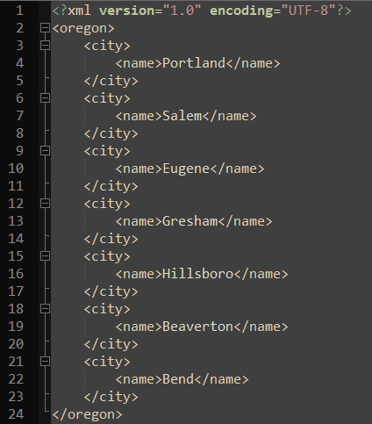
Or Use an XML File
An XML file listing seven cities in Oregon
Note the first line declaring the contents of this file to be XML.
Note how each node has a corresponding closing node.
HTML, is kind of an html. <h1>…</h1>
Pseudocode to print city names from this file:
For each node named city:
print city.name

Slide 38
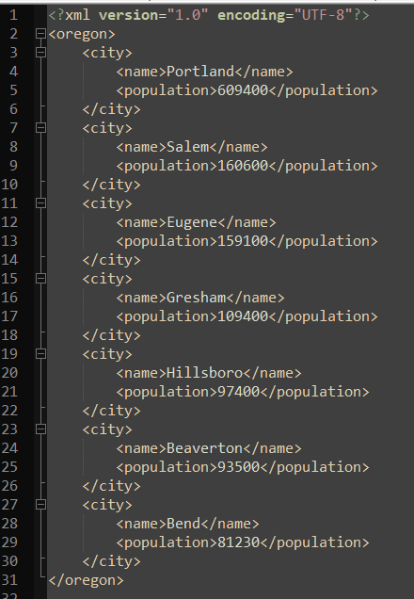

XML Files
Adding population node corresponding to each city.
Does our old code still work?
One of the biggest advantage of using standardized structure.

Slide 39
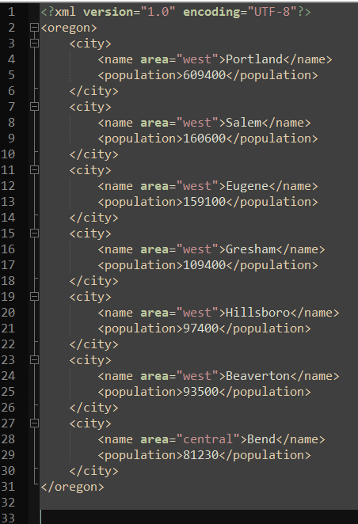
XML: Node Values and Attributes

Slide 40
Questions

Slide 41
AJAX. What is it good for?
Old school (synchronous full page refresh)
Click a link, wait for page to load, submit a form, wait for page to load, click a link, wait for page…
New school (asynchronous partial refresh)
As you use a webpage, actions are triggered which gather additional information from the server and respond without requiring you to refresh the page.
More complicated, but much more usable

Slide 42
How asynchronous partial refresh works
Web page UI
Your AJAX code
Web server
Type or click
Request action
Update UI
Send message to server
User sees the action started
Server sends back some data
Update UI
User sees the action is done

Slide 43

Steps:
A click, or something user typed – starts an action
A JS function is called [e.g. makeRequest()], which “asynchronously” calls a server based service
UI may reflect this so user knows action has started
Server eventually replies: a callback JS function is invoked [e.g. receiveServerAnswer()]
Callback function processes the results and updates front end accordingly.

Slide 44
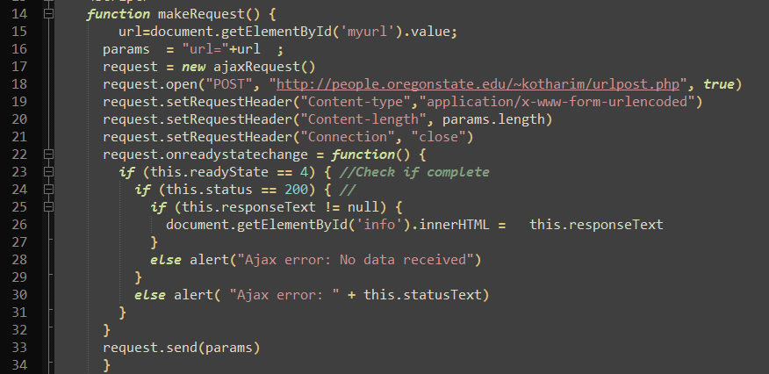
Creating an AJAX Reqeuest
http://people.oregonstate.edu/~kotharim/urlpost.html

Slide 45
Same Origin Policy
In general, you can only load data from the same web site that your main html came from
This is called the "same origin policy"

Slide 46
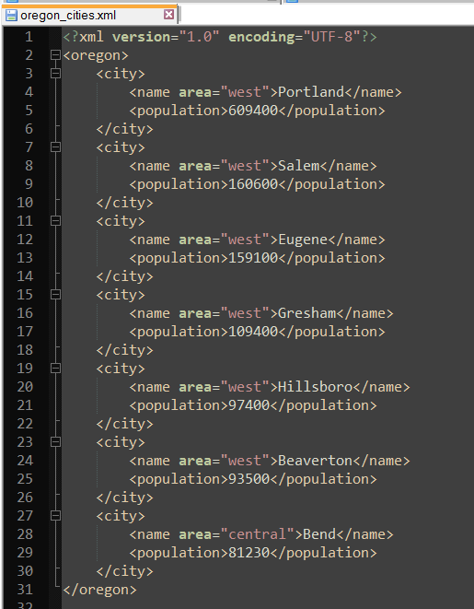
Reading XML Files
http://people.oregonstate.edu/~kotharim/oregon_cities.xml

Slide 47
A sample PHP Service
http://people.oregonstate.edu/~kotharim/read_oregon_cities.php

Slide 48
Lets use that service
http://people.oregonstate.edu/~kotharim/readxml.html

Slide 49
Questions?

Slide 50
Homework #2: Using Javascript and AJAX
Update the page you created in HW1 so that the content on the page is dynamically loaded. OR Create a new page.
Place it on the onid servers. Do we know how?
Create a static XML or JSON to store data you intend to dynamically populate.
Use http://people.oregonstate.edu/~kotharim/read_oregon_cities.php as your back-end service.
Retrieve this using AJAX
Process some nodes from the result.
Process and display this data on the webpage.
Explain why you chose to dynamically populate this data.
Send me a link to your webpage

Slide 51
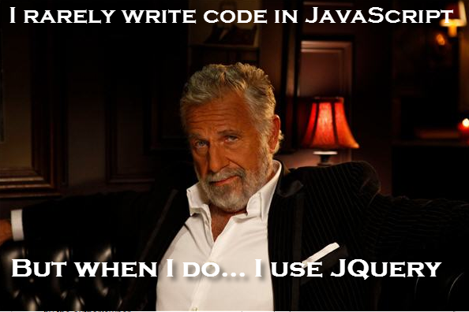
JQuery

Slide 52
JQuery Syntax
In JQuery, you select elements and optionally perform actions on them.
$(query);
$(query).action();
For example:
$(“h1”). attr("style","color:#6666ff");
$(“#someid”).hide();
$(“.someclass”).hide();

Slide 53
Body onLoad
If you want to do some operation upon your page but don’t want it to start until the page is loaded.
onload event on a page gets triggered after all elements on a page are loaded, including images.

Slide 54
$document.ready()
What if you don’t want to wait until all the events to be loaded?
-for example, an image you reference is based on a server that is always slow.
Cue in $document.ready(). It gets triggered as soon as your DOM is ready.

Slide 55
Selecting Elements
As mentioned earlier, JQuery syntax can be viewed as: $(query).action()
What goes into query?
$( "#myId" );
$( ".myClass" );
$( "#content img" );

Slide 56
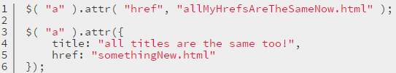
The .attr()
The .attr() method acts as both a getter and a setter. As a setter, .attr() can accept either a key and a value, or an object containing one or more key/value pairs.
.attr() as a setter:
.attr() as a getter:

Slide 57

Performance
Lets take a step back and discuss performance.
What is wrong with the following code:

Slide 58
Performance
Similarly when using JQuery selectors, there is a factor called too-much-specificity
For example: If $(“#myid img”) will do, then why use $(“#myid p img .imgclass”);

Slide 59
More generic selectors
$("p:first")
$("tr:even")
$("tr:odd")
$("a[target='_blank']")
$(“href”)
Chaining: $(“p”).find(“.myclass”).eq(2).hide();

Slide 60
Resources
There are many online resources out there.
jQuery Cookbook – free online downloads available.

